Slide 1
Java – Phase 2
Upskilling
Spring Framework
Diwahar Sundar
Satesh Kumar Hariharan
January 23, 2023.

Slide 2
Curriculum
Introduction
Spring Boot
Spring MVC
Spring ORM
Spring Security

Slide 3
23-Jan-2023
Introduction
Spring Boot
Spring MVC
Spring ORM
Spring Security
History
Downsides of JavaEE
Spring Framework
Spring IOC
Spring Beans
Spring Scope
Spring Autowire
Introduction
First Project using Spring Boot

Slide 4
A Bit of History
The Java EE stands for Java Enterprise Edition, which was earlier known as J2EE and is currently known as Jakarta EE.
The Java EE provides a platform for developers with enterprise features such as distributed computing and web services.
Java EE applications are usually run on reference run times such as micro servers or application servers.
Examples of some contexts where Java EE is used are e-commerce, accounting, banking information systems.
The Java EE contains several APIs which have the functionalities of base Java SE APIs such as Enterprise JavaBeans, connectors, Servlets, Java Server Pages and several web service technologies.

Slide 5
Setting Up Java EE Application
Step 1: Download Application Server e.g., Webshere, GlassFish, Weblogic etc.
Step 2: Configure the Application Server.
Step 3: Create a JavaEE Project in IDE with the help of Application Runtime.
Step 4: Create an Application Server run configuration in our IDE.
﻿Step 5: Package the application into a WAR with the help of Ant or Maven Script.
Step 6: Package the application into an EAR﻿.
Step 7: Deploy the EAR artifact﻿.
Step 8: Start the Application Server.

Slide 6
Downsides of Java EE Apps
Requires larger investments for development, deployment, maintenance, and management.
The application development environment is extremely complex;
Doesn’t have built-in support for web services standards.
Requires deep learning due to the excess number of specifications.
Is difficult to use for quick-turnaround, low-cost and mass-market projects.

Slide 7
We Really Need An Alternate…

Slide 8
Spring Framework
Spring framework is an open-source Java platform that provides comprehensive infrastructure support for developing robust Java applications very easily and very rapidly.
Spring framework was initially written by Rod Johnson and was first released under the Apache 2.0 license in June 2003.
Spring is the most popular application development framework for enterprise Java.
Millions of developers around the world use Spring Framework to create high performing, easily testable, and reusable code.
Most Importantly, Spring framework is an open-source platform.

Slide 9
Spring Framework - Pros
Modular - Spring is organized in a modular fashion. Even though the number of packages and classes are substantial, you have to worry only about the ones you need and ignore the rest.
Integration with existing frameworks - Spring does not reinvent the wheel, instead it truly makes use of some of the existing technologies like several ORM frameworks, logging frameworks, JEE, Quartz and JDK timers, and other view technologies.
Web MVC - Spring's web framework is a well-designed web MVC framework, which provides a great alternative to web frameworks such as Struts or other over-engineered or less popular web frameworks.

Slide 10
Spring Framework - Pros
Central Exception Handling - Spring provides a convenient API to translate technology-specific exceptions (thrown by JDBC, Hibernate, or JDO, for example) into consistent, unchecked exceptions.
Transaction management - Spring provides a consistent transaction management interface that can scale down to a local transaction (using a single database, for example) and scale up to global transactions (using JTA, for example).
Lightweight - Lightweight IoC containers tend to be lightweight, especially when compared to EJB containers, for example. This is beneficial for developing and deploying applications on computers with limited memory and CPU resources.

Slide 11
Spring IOC
The Spring container is at the core of the Spring Framework.
The container will create the objects, wire them together, configure them, and manage their complete life cycle from creation till destruction.
The Spring container uses DI to manage the components that make up an application. These objects are called Spring Beans, which we will discuss in the next slide.
The container gets its instructions on what objects to instantiate, configure, and assemble by reading the configuration metadata provided.
The configuration metadata can be represented either by XML, Java annotations.
Spring provides the following two distinct types of containers: Spring BeanFactory Container & Spring ApplicationContext Container.

Slide 12
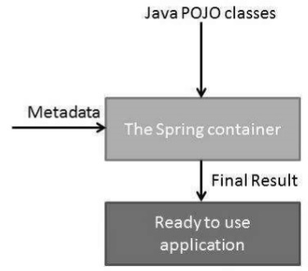
Spring IOC

Slide 13
Spring Beans
The objects that form the backbone of your application are called beans.
These beans are created with the configuration metadata that you supply to the container.
A bean is an object that is instantiated, assembled, and otherwise managed by a Spring IoC container.
In order to create java beans two things are mandatory: Constructors, Getters & Setters.
Following are the three important methods to provide configuration metadata to the Spring Container: XML based configuration file, Annotation-based configuration & Java-based configuration.

Slide 14
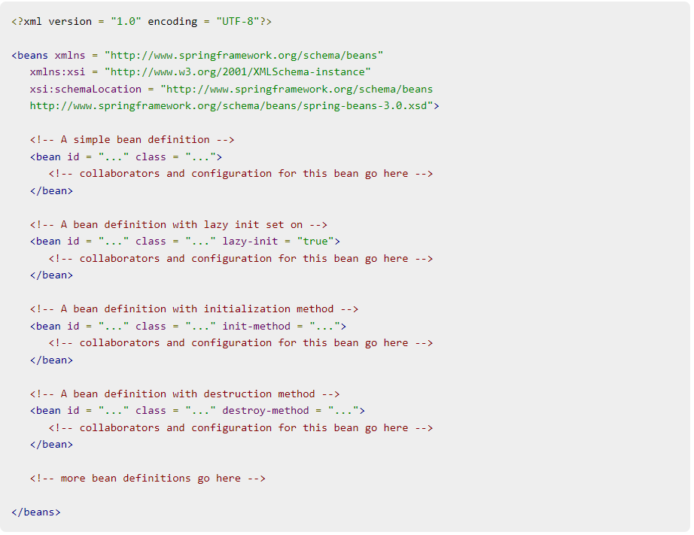
Spring Bean Definition – XML Configuration

Slide 15
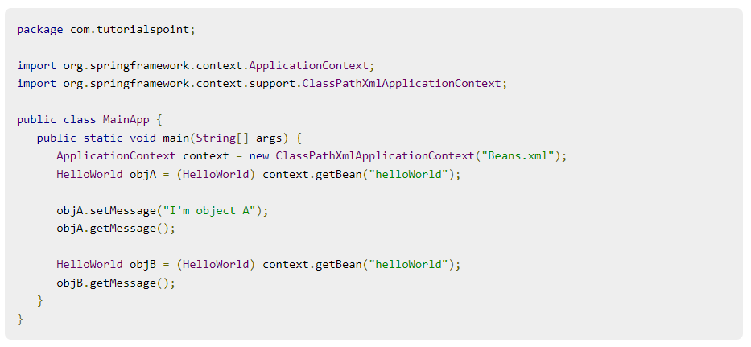
Creating your First Object in Spring

Slide 16
Spring Bean Scope
When defining a <bean> you have the option of declaring a scope for that bean.
For example, to force Spring to produce a new bean instance each time one is needed, you should declare the bean's scope attribute to be prototype.
Similarly, if you want Spring to return the same bean instance each time one is needed, you should declare the bean's scope attribute to be singleton.
Scopes:
Singleton
Prototype
Request
Session
Global-Session

Slide 17
Spring - Autowire
When defining a <bean> you have the option of declaring a scope for that bean.
The Spring container can autowire relationships between collaborating beans without using <constructor-arg> and <property> elements, which helps cut down on the amount of XML configuration you write for a big Spring-based application.
The @Autowired annotation can apply to bean property setter methods, non-setter methods, constructor and properties.
Annotating a class with the @Configuration indicates that the class can be used by the Spring IoC container as a source of bean definitions
The @Bean annotation tells Spring that a method annotated with @Bean will return an object that should be registered as a bean in the Spring application context

Slide 18
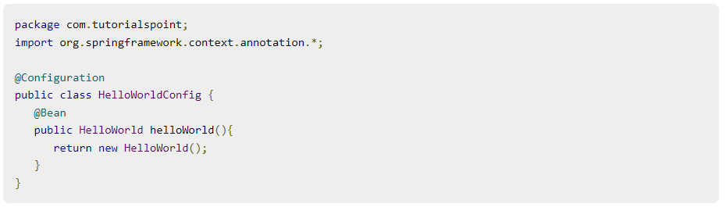
Spring Bean Configuration: Java Based Configuration

Slide 19
Maven
Maven is the most popular build and dependency resolution tool for Java, just like NPM is for JS.
Maven in its purest form follows a declarative model, where pom.xml (similar to package.json) defines different properties of the build, but contains no scripts
Maven is a project management and comprehension tool that provides developers a complete build lifecycle framework. Development team can automate the project's build infrastructure in almost no time as Maven uses a standard directory layout and a default build lifecycle.
In Maven, the basic form of these coordinates is GAV (groupId, artifactId, version).

Slide 20
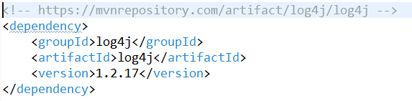
A Maven Dependency

Slide 21
Setting Up A Spring Application
Step 1 - Create Java Project.
Step 2 - Add Required Dependencies.
Step 3 - Create Java Files.
Step 4 - Create Bean Configuration File.
Step 5 - Download Web Server like Tomcat.
Step 6 - Deploy the WAR Artifact.
Step 7 - Running the Program.

Slide 22
Downsides of Spring Applications
Still requires a separate web or application server.
Configurations files to prepare.
Not suitable for creating microservices.

Slide 23
Spring Boot

Slide 24
Spring Boot
Spring Boot makes it easy to create stand-alone, production-grade Spring based Applications that you can "just run".
Spring Boot is an open-source Java-based framework used to create a MicroServices.
In Spring Boot, everything is auto configured; no manual configurations are needed.
Driven by Annotations.
Eases dependency management
It includes Embedded Servlet Container i.e., A Web Server.

Slide 25
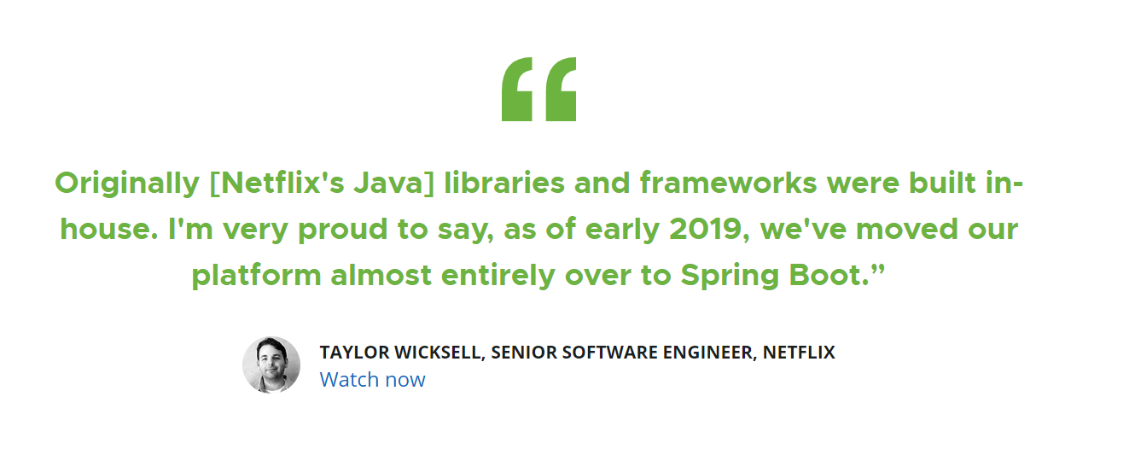
Recognition from Netflix

Slide 26
Creating Your First Project in Spring Boot
Visit https://start.spring.io/
Create a Project.
Download in eclipse.
Run it.

Slide 27
More to Come..

Slide 28
24-Jan-2023
Introduction
Spring Boot
Spring MVC
Spring ORM
Spring Security
Spring Rest Controller
Spring Bill Of Materials
Annotations

Slide 29
Spring MVC
Spring MVC Framework follows the Model-View-Controller design pattern. It is used to develop web applications.
It works around DispatcherServlet. DispatcherServlet handles all the HTTP requests and responses. It dispatches the requests to handlers.
Model: The Model encapsulates the application data.
View: View renders the model data and generates HTML output that the client’s browser can interpret.
Controller: The Controller processes the user requests and passes them to the view for rendering.

Slide 30
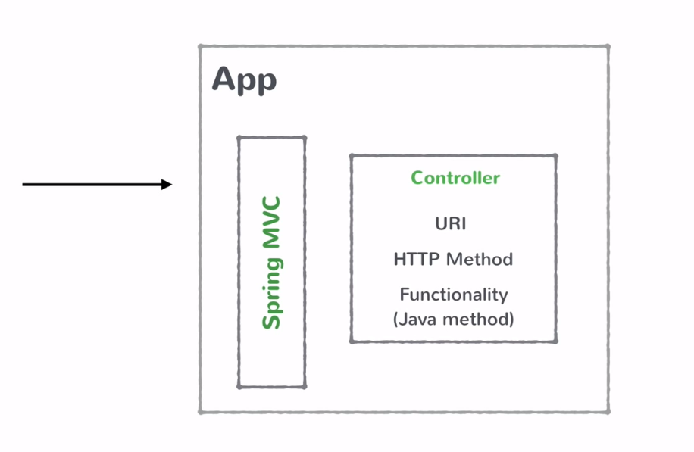
How Spring MVC Works?

Slide 31
Pros of Using Spring MVC
Easier to Update the application.
It is Easier to Debug because we have multiple levels in the application.
Development of the application becomes fast.
It enables rapid and parallel development.
It uses light-weight servlet container to develop and deploy your application.
Easy to test.

Slide 32
Spring Rest Controller
Spring Boot Controller lets you map requests to responses.
Annotated with @RestController Annotation
These Controllers are nothing but java classes.
Controllers map the URI and the HTTP method to some java methods.
After the executions, these controllers returns responses back to the caller.
We generally build a bunch of controllers and deploy them in a SpringBootApplication.
The Responses are converted into a proper format and then returned to the caller.

Slide 33
Spring Rest Controller
RestController is used for making restful web services with the help of the @RestController annotation.
This annotation is used at the class level and allows the class to handle the requests made by the client.
The RestController allows to handle all REST APIs such as GET, POST, Delete, PUT requests.

Slide 34
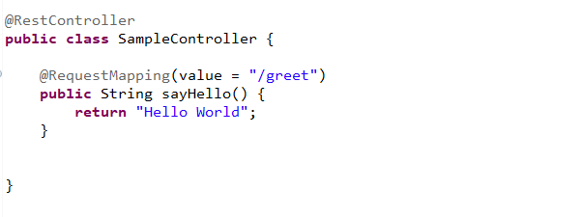
Spring Rest Controller

Slide 35
Building a Business Service in Spring Boot
Spring @Service annotation is used with classes that provide some business functionalities.
It is used to mark the class as a service provider.
Spring context will autodetect these classes when annotation-based configuration and class path scanning is used.

Slide 36
Stay Tuned…

Slide 37
25-Jan-2023
Introduction
Spring Boot
Spring MVC
Spring ORM
Spring Security
Annotations
Spring ORM
Configuring H2 Database

Slide 38
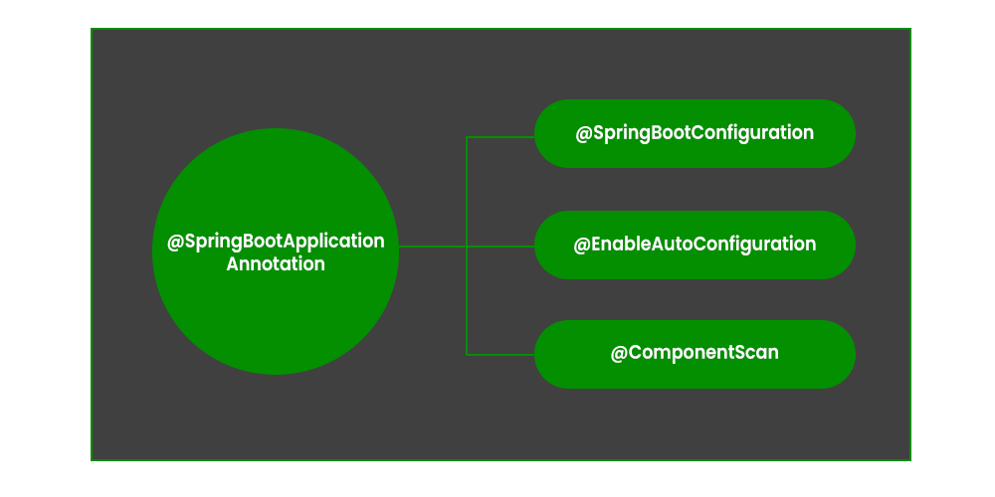
SpringBootApplication

Slide 39
EnableAutoConfiguration
The annotation @EnableAutoConfiguration is used to enable the auto-configuration feature.
The @EnableAutoConfiguration annotation enables the auto-configuration of Spring ApplicationContext by scanning the classpath components and registering the beans.

Slide 40
Configuration
Spring Configuration annotation indicates that the class has @Bean definition methods.
Spring container can process the class and generate Spring Beans to be used in the application.

Slide 41
Component Scan
We use the @ComponentScan annotation along with the @Configuration annotation to specify the packages that we want to be scanned.
@ComponentScan without arguments tells Spring to scan the current package and all its sub-packages.

Slide 42
Component
@Component is an annotation that allows Spring to automatically detect our custom beans.
Scan our application for classes annotated with @Component
Instantiate them and inject any specified dependencies into them
Inject them wherever needed.

Slide 43
Spring ORM
Spring-ORM is a technique or a Design Pattern used to access a relational database from an object-oriented language. ORM (Object Relation Mapping) covers many persistence technologies
JPA(Java Persistence API): It is mainly used to persist data between Java objects and relational databases. It acts as a bridge between object-oriented domain models and relational database systems.

Slide 44
Benefits of Using Spring ORM
Less coding is required: By the help of Spring framework, you don't need to write extra codes before and after the actual database logic such as getting the connection, starting transaction, committing transaction, closing connection etc.
Easy to test: Spring's IoC approach makes it easy to test the application.
Better exception handling: Spring framework provides its own API for exception handling with ORM framework.
Integrated transaction management: By the help of Spring framework, we can wrap our mapping code with an explicit template wrapper class or AOP style method interceptor.

Slide 45
Spring Boot In-Memory Database
In-memory database relies on system memory as opposed to disk space for storage of data.
The widely used in-memory databases are H2, HSQLDB (HyperSQL Database), and Apache Derby.
It is helpful for POCs (Proof of Concepts), not for a production application.
The widely used in-memory database is H2.

Slide 46
What is the H2 Database?
H2 is an embedded, open-source, and in-memory database. It is a relational database management system written in java.
It is a client/server application.
It is generally used in unit testing. It stores data in memory, not persist the data on disk.

Slide 47
Stay Tuned…

Slide 48
27-Jan-2023
Introduction
Spring Boot
Spring MVC
Spring ORM
Spring Security
Authentication & Authorization
JWT Token
OAuth2.0
CORS
CSRF
XSS

Slide 49
IoT without Security is nothing but Internet of Threats

Slide 50
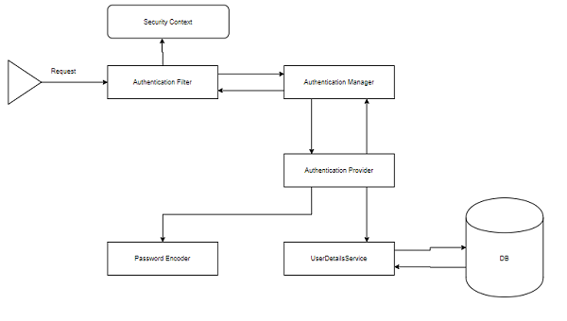
Authentication & Authorization

Slide 51
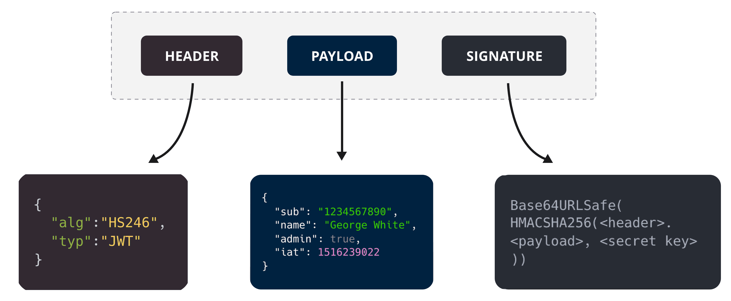
JWT Token
JSON Web Token is an open Internet standard for securely transmitting trusted information between parties in a compact way.
Structure: [Header].[Payload].[Signature]

Slide 52
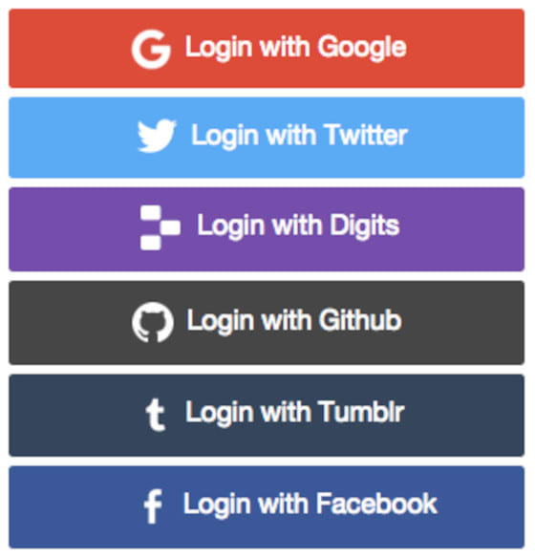
OAuth 2.0
OAuth 2.0 stands for “Open Authorization”, is a standard design to allow a website or application to access resources hosted by other web apps on behalf of a user

Slide 53
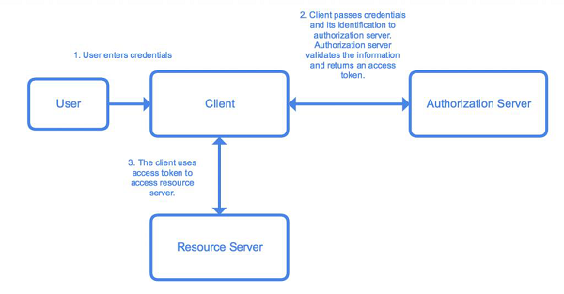
OAuth 2.0

Slide 54
OAuth 2.0
spring.security.oauth2.client.registration.google.client-id=<client id>
spring.security.oauth2.client.registration.google.client-secret=<client secret>
spring.security.oauth2.client.registration.facebook.client-id=<client id>
spring.security.oauth2.client.registration.facebook.client-secret=<client secret>
spring.security.oauth2.client.registration.github.client-id=<client id>
spring.security.oauth2.client.registration.github.client-secret=<client secret>

Slide 55
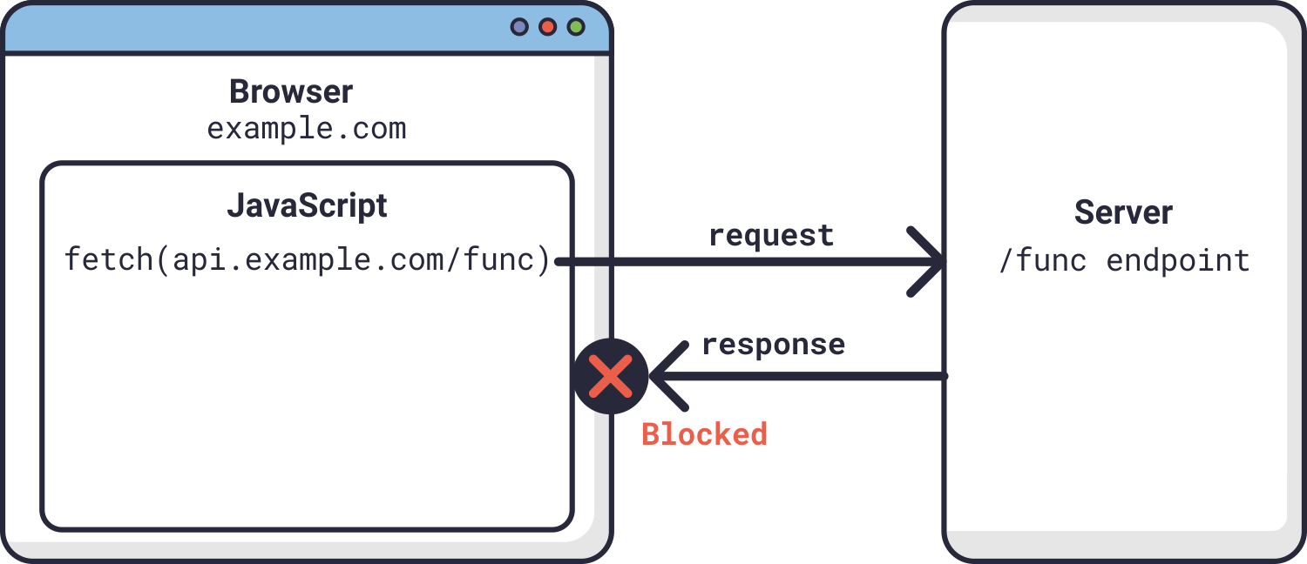
CORS
CORS (Cross-Origin Resource Sharing) is a security feature implemented by web browsers to prevent a web page from making requests to a different domain than the one that served the web page.

Slide 56
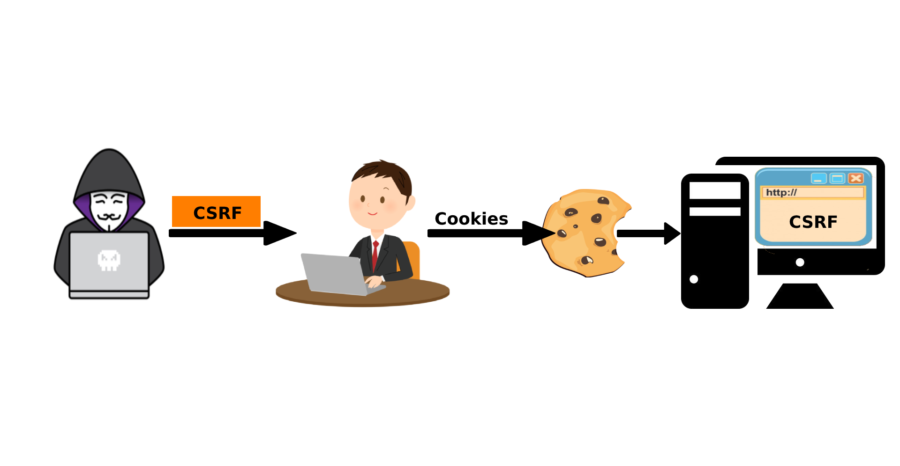
CSRF
CSRF (Cross-Site Request Forgery) is a type of security vulnerability that occurs when an attacker can trick a user into performing an unintended action on a web application, such as changing their password or making a purchase.

Slide 57
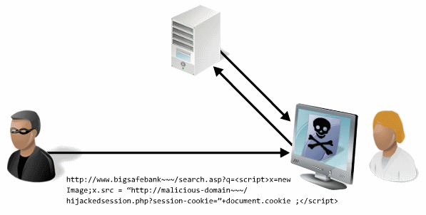
XSS
Cross-Site Scripting (XSS) is a type of security vulnerability that allows an attacker to inject malicious scripts into web pages viewed by other users.

Slide 58
Prevention is better than cure. If you don’t want others to hack your system, then upgrade it before they do.

Slide 59
Feedback Time

Slide 60
Thank you

